Slide 1
The Rising Costs of Higher Education & Its Effects on Enrollment
Aziz Zoher Khilawala
Dandrew Merriweather
Hawra Rabaan
Keyur Kirti Mehta
Lisha Chen
Robert Crouch
Tariq Khan
Sagar Salvi

Slide 2
Goal Setting and Planning

Slide 3



Goal Setting and Planning
Brainstorming
Team strengths + experience
Leveraged tech to bring 8 people in one place
Google drive : central hub for documenting ,
Whatsapp: communication + planning, Google hangout
Defined a hypothesis + possible outcomes
Divided outcome tasks among group
Notes:
Personal story about approaching postsecondary education
Team member strengths: who wants to learn what + who has experience with what
Google drive as a central hub for planning + documenting , Whatsapp for communication
Leveraged tech to bring 8 people in one place
Defined a hypothesis + possible outcomes → divided outcome tasks among group

Slide 4
Hypothesis

Slide 5
Hypothesis
The increasing cost of tuition for all levels of post secondary school in the United States has had a direct impact on the percentage of eligible* individuals’ enrollment in those programs.
*Eligible Persons: Individuals ages 16 to 24 who graduated from high school or completed a GED or other high school equivalency credential [6].
Notes:
The National Center for Education Statistics defines eligible persons in their data as, “Individuals ages 16 to 24 who graduated from high school or completed a GED or other high school equivalency credential [3].” Because of this much of our data was based on eligible persons rather than overall population in the United States.

Slide 6
Research Design

Slide 7



Research Design
Online database resources
Multiple Visualization Methods
Final report

Slide 8
Methodology

Slide 9



Methodology
Data Gathering : multiple credible online sources
Institutions that gather data in private and public sectors, on enrollment and tuition costs.
Data Preprocessing: using Microsoft Excel
Data Integration: to MySQL
Data Normalization: Python
Visualization
Various tools based on the team’s individual strengths.
To compare against the hypothesis
Determine outcome.
Analysis: observation + literature
Notes:
Data had to be preprocessed using Microsoft Excel in order to be ready for the other data visualization programs.
Preprocessed data was uploaded to MySQL.
Choice of visualization tool was dependent on the team’s individual strengths.
Visualizations were used to compare against the hypothesis and determine the study’s outcome.

Slide 10
Visualization & Analyses
Notes:
Data is based on eligible people to be enrolled (percentage)

Slide 11
Potential Outcomes
Overall tuition is on the rise in The United States
University growth rates are slowing
Trade school and community college growth rates are increasing
Postgraduate education programs enrollment will show a decreasing trend
Notes:
We divided our hypothesis into 4 different parameters. And visualized the data based on those parameters

Slide 12
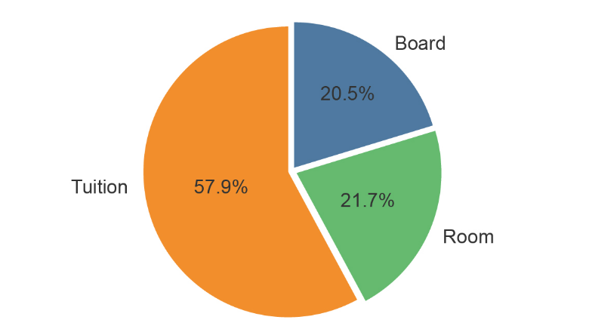
Outcome 1. Overall tuition is on the rise in The United States
Education Costs Breakdown
Notes:
breakdown of other expenses that factor into educational costs.[6] While our database analysis focused on tuition costs alone, it is important to know the average students across the United States have other costs directly associated with their higher education decisions. A breakdown of the average costs shows that tuition may account for nearly 58% of all costs, while room and board costs can also weigh heavily on a student’s budget, almost evenly splitting the other 42% in education associated expenses.

Slide 13
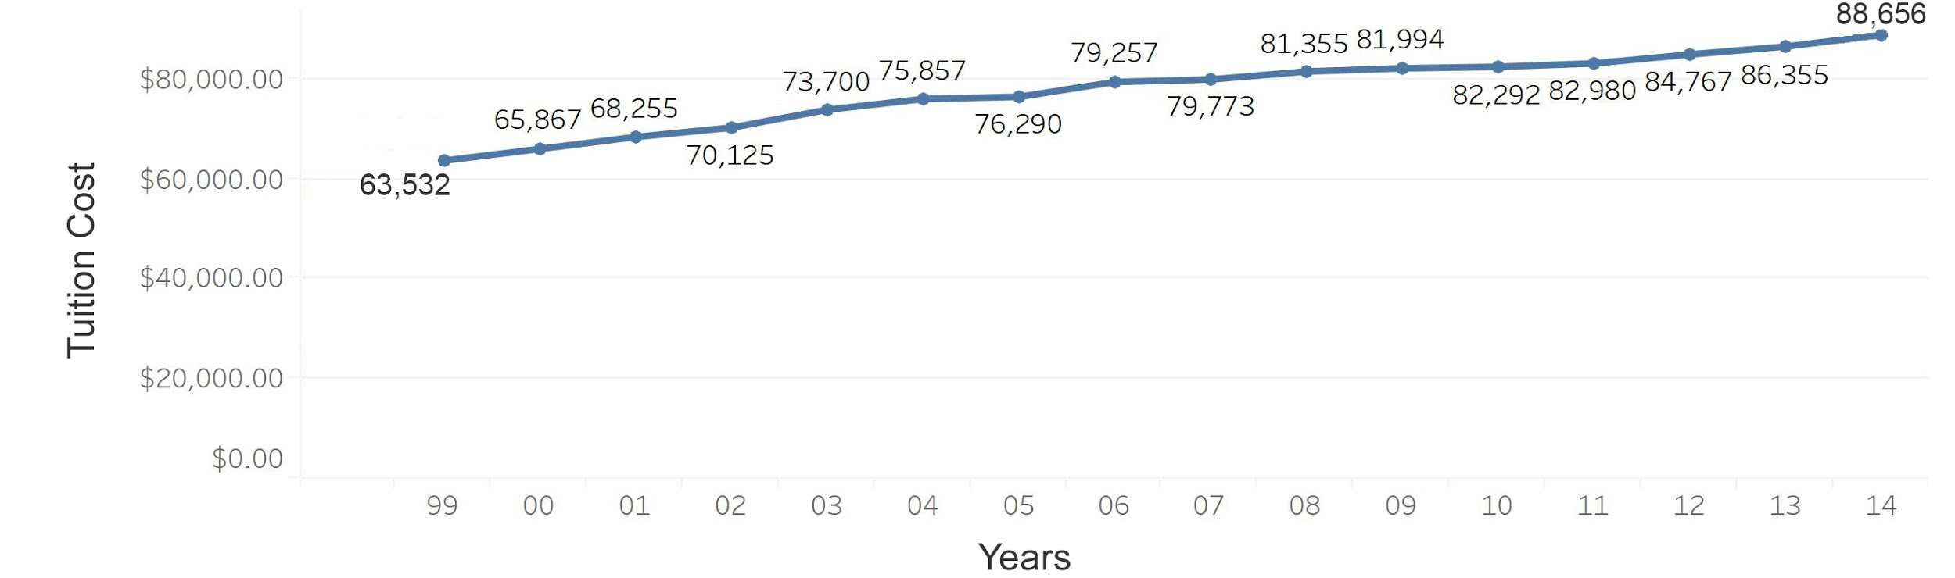

Outcome 1. Overall tuition is on the rise in The United States
Tuition Cost Trends
Tuition costs have been steadily rising from 99-14.
Notes:
In the original hypothesis we theorized that tuition has been on the rise, while it may be true that the dollar amount has risen, it could be argued that it hasn’t risen at all in the past two decades depending on what it is being compared to. Figure 1 above, shows an increase with rates averaging around $65,000.00 in 1999, while steadily increasing to $88,000.00 in 2014.[3] Tuition increased on average 1.7% each year which is interestingly less than the average rate of inflation in the United States at 1.9% over those same years.[4] With inflation factored in, one could argue that tuition rates have actually not risen at all over these 15 years, they may have actually dropped in comparison by 0.2%. However with factors such as the modern recession in the United States, it could also be argued that the average tuition rate was lower simply because students were favoring a less expensive education in times of economic stress. In these same years the median household income did not rise, in fact is was on the decline from $58,665 in 1999 to $54,398 in 2014 with an all time low of $53,331 in 2012.[5] It is no secret that the United States was in a recession and that it certainly affected many aspects of people's lives when it came to spending money. For further explanation we must look at other data.

Slide 14
Outcome 1. Overall tuition is on the rise in The United States
Tuition Cost Trends
Tuition
Inflation
Median household Income
Financial assistance
Notes:
In the original hypothesis we theorized that tuition has been on the rise, while it may be true that the dollar amount has risen, it could be argued that it hasn’t risen at all in the past two decades depending on what it is being compared to. Figure 1 above, shows an increase with rates averaging around $65,000.00 in 1999, while steadily increasing to $88,000.00 in 2014.[3] Tuition increased on average 1.7% each year which is interestingly less than the average rate of inflation in the United States at 1.9% over those same years.[4] With inflation factored in, one could argue that tuition rates have actually not risen at all over these 15 years, they may have actually dropped in comparison by 0.2%. However with factors such as the modern recession in the United States, it could also be argued that the average tuition rate was lower simply because students were favoring a less expensive education in times of economic stress. In these same years the median household income did not rise, in fact is was on the decline from $58,665 in 1999 to $54,398 in 2014 with an all time low of $53,331 in 2012.[5] It is no secret that the United States was in a recession and that it certainly affected many aspects of people's lives when it came to spending money. For further explanation we must look at other data.

Slide 15
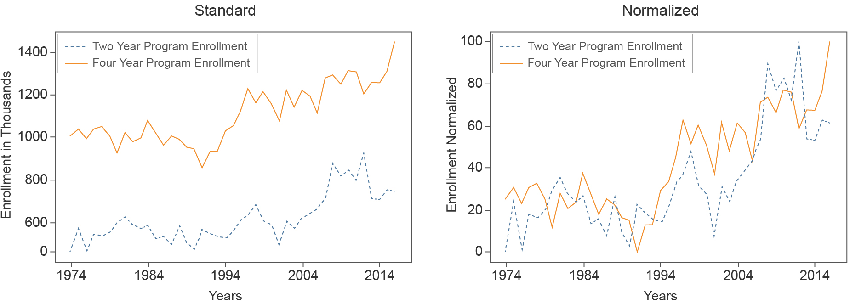
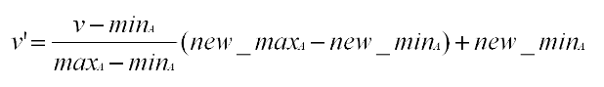
Outcome 2. University growth rates are slowing
University Enrollment Trends:
Despite the increase in tuition hikes, enrollment at 4 yr and 2 yr programs actually increased.
Min-Max Normalization:
Notes:
In Figure 3 the enrollment graphs show a healthy increase in four year programs at universities between 1990 through 1996. Although we anticipate there will be natural fluctuation in numbers there is a noticeable drop in enrollment starting in 2000. After normalizing the data using the formula covered in Formula 1 below and bringing the two datasets into a common range, it is easier to compare the rates of growth.
A noticeable change in trends can be seen in 2006 where two year programs start to gain enrollment at a higher rate than four year programs. As touched on in outcome section (3.1), we hypothesize this may be a combination of rising tuition rates along with a drop in median household income levels in the United States and economic uncertainty.

Slide 16
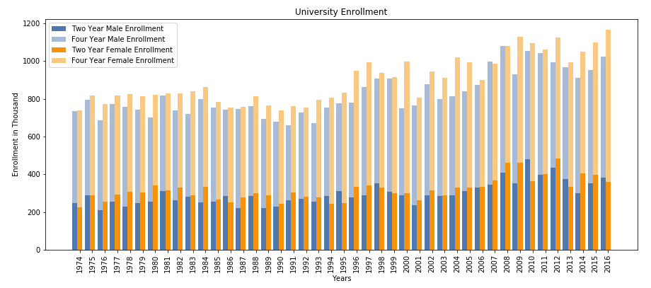
Outcome 2. University growth rates are slowing
University Enrollment Trends:
To account for the discrepancy between male and female enrollment :
Families expected less males to go to college , parents would not plan financially for their child to attend whereas with females they started planning for college from an early age. [3]
Notes:
The data used in figures 4 and 5 was derived from a count of highschool graduates between the age of 18-24, and the percentage of these high school graduates enrolled to the different university programs from 1974 to 2016. Enrollment was then categorized on gender basis and then sub categorized as enrolled to 2 year and 4 year university programs. Gender based enrollment shows a steady growth rate and normal fluctuations up until the year 2000, where we see a dramatic drop in male enrollment in Figure 4. This trend holds true several other years off and on through the decade that follows.
There is no definitive explanation for this anomaly in the data, however, it could be argued there is a correlation between the 9/11 terrorist attacks on the Twin Towers in New York and male enrollment rates in the united states. Although the drop in enrollment is small, it is correlated with small increases in enlistment in America’s varying armed forces after they were experiencing lower numbers than previous years.
In 2001 when the attacks occurred we see that the male enrollment seems to remain in an established state of balance with female enrollment. However in 2003 when Operation Iraqi Freedom was officially launched one will notice the enrollment gap starts to increase between the sexes. Furthermore, in 2006 the data shows the averages return to steady balance while enlistment numbers were on the decline for branches of the military.
When comparing two year programs with four year programs over the same amount of time, as shown in Figure 5, we see very little differences except the fact that there are many more years where the male population outweighs the female population in enrollment. Stage et al suggests, that the modern education gender gap is caused by families educational aspirations from an early age and their expectations after high school. Based on their study, families expected less males to go on to college and thus parents would not plan financially for their child to attend, whereas with females, a higher percentage responded that they started planning for college from an early age.[9] This may attribute to the two year versus four year gender gap.

Slide 17
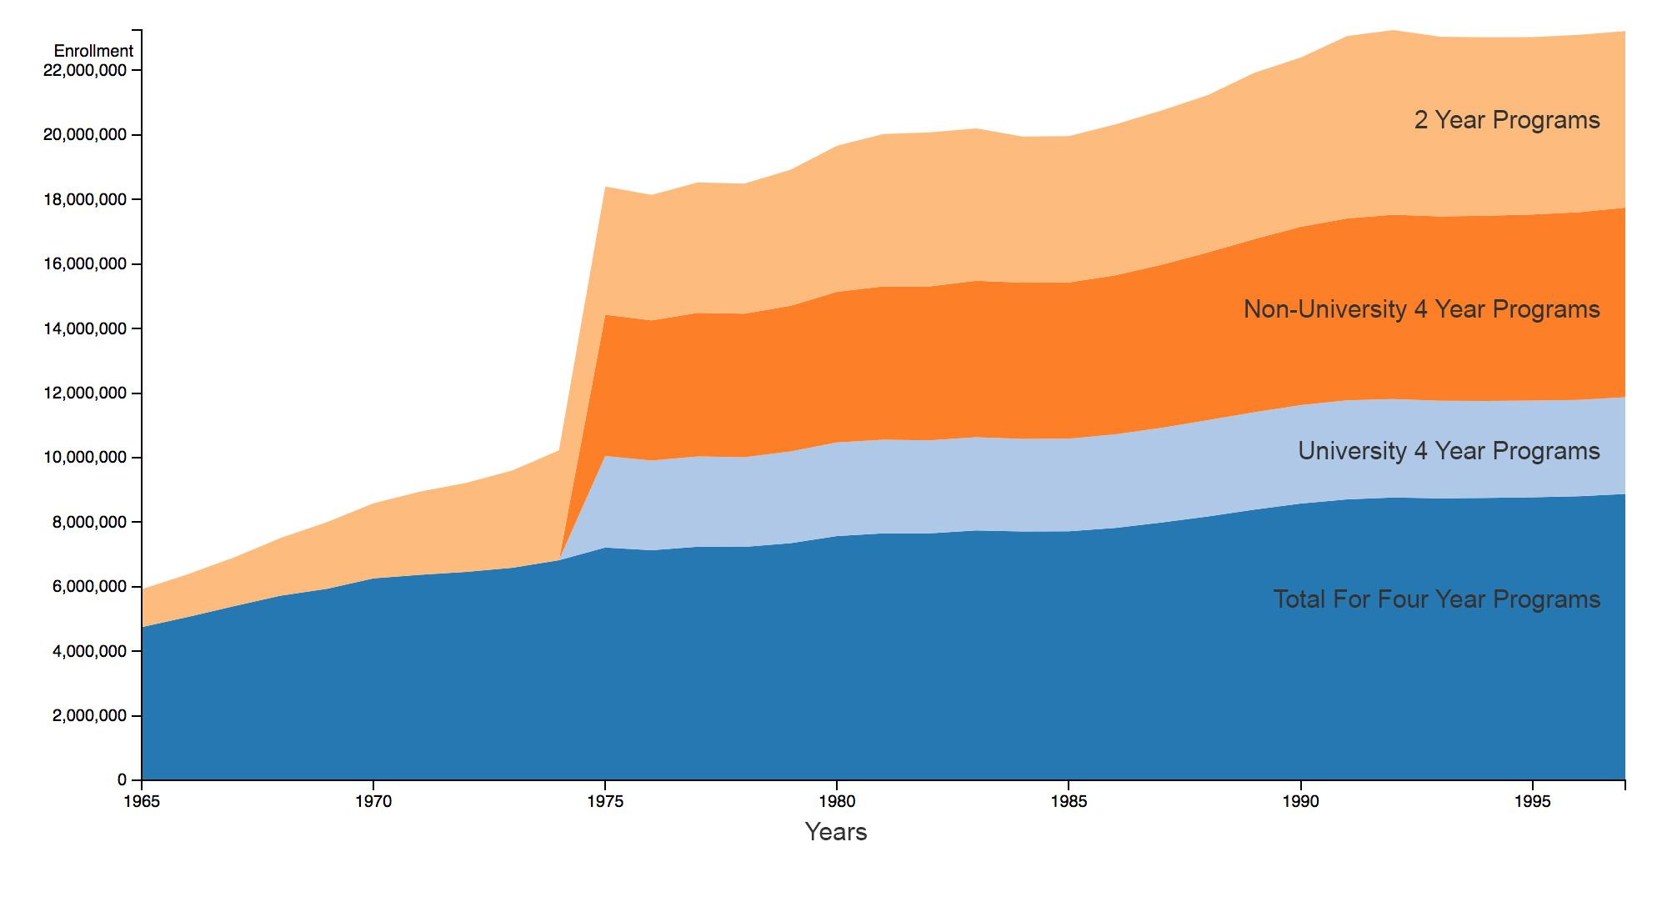

Outcome 3. Trade school and community college growth rates are increasing
Vocational School Trends:
Enrollment rates in trade schools has increased steadily since 1985.
1970s spike in programs: data’s sudden inclusion of new nationally recognized schools.
Notes:
Enrollment rates in trade schools has increased steadily since 1985. Earlier anomalies such as the 1970s spike in programs is explained by the data’s sudden inclusion of new nationally recognized schools. These trends are not dramatically different from the overall traditional college trends. One can theorize that this is due to the fact that there is still an increasing trend towards obtaining an education, trade school or otherwise, despite a drop in financial assistance.[12]

Slide 18
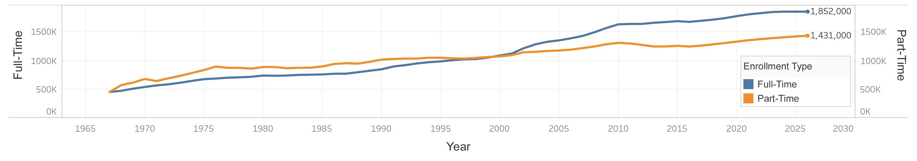
Outcome 4. Post graduate education programs enrollment will show a decreasing trend
Full time Vs. Part Time Postgraduate Enrollment
Increased number of enrollment in post graduate institutions.
Why: job scarcity; undergraduate students decide on furthering their education rather than entering the workforce. [1]
Notes:
This could be due to a lack of jobs causing undergraduate students to decide on furthering their education immediately after finishing their undergrad rather than entering the workforce.
- Although the issue may not have anything to do with job availability and everything to do with experience. An article in the Harvard Business Review states that around two-thirds of college graduates have a hard time launching their career on a bachelor's degree, causing many to pursue further schooling at the certificate, masters, or Phd level.
It is worth noting that although part-time students may no longer lead in enrollment, they are by no means declining.

Slide 19
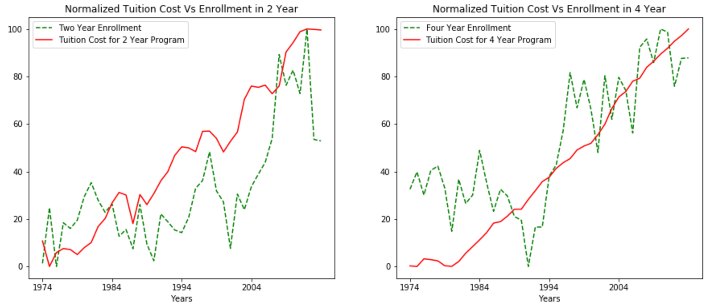
Total Tuition vs Enrollment
2 year:
Increased enrollment
Increased tuition
Exponential growth post-2000
4 year:
Increased tuition
High growth late 90s
Notes:
Finally, we thought it was important to visualize the enrollment rates compared to tuition rates over time. In the previous tuition section the data was focused on a fraction of the data from 1999 to 2014 but below in Figure 8 we see how tuition has trended from 1974 to 2014 with enrollment.
-One may notice immediately that four year tuition rates rise at a much steadier predictable rate as opposed to two year institutions. The normalized line chart in figure 8 is quite revealing in regards to how tuition may influence enrollment rates. Four year institutions enrollment seem to be completely independent from tuition rates whereas two year enrollment rates highly correlate. One could theorize that persons looking to enroll in two year programs are more likely to make that decision based on cost of tuition. It would seem that after each sharp drop in two year enrollment the institutions lower tuition as an incentive to raise enrollment once again. The same cannot be said for four year enrollment, each time we see a drop in enrolment tuition rates continue to increase over time.
Our above observations hold true when reviewing the scatter plots in Figure 9. It is clear that those enrolling in two year institutions favor lower tuition rates, when referencing the normalized line charts we can infer that the dots indicating higher cost enrolment are the more recent years where we have observed spikes in enrollment. Although we see some fluctuation in the four year plot overall both tuition and enrollment are considered to be steadily rising. Which in the end, disproves our hypothesis for four year enrollment, although it could be argued that the hypothesis is proven true is only applied to two year enrollment and tuition.

Slide 20
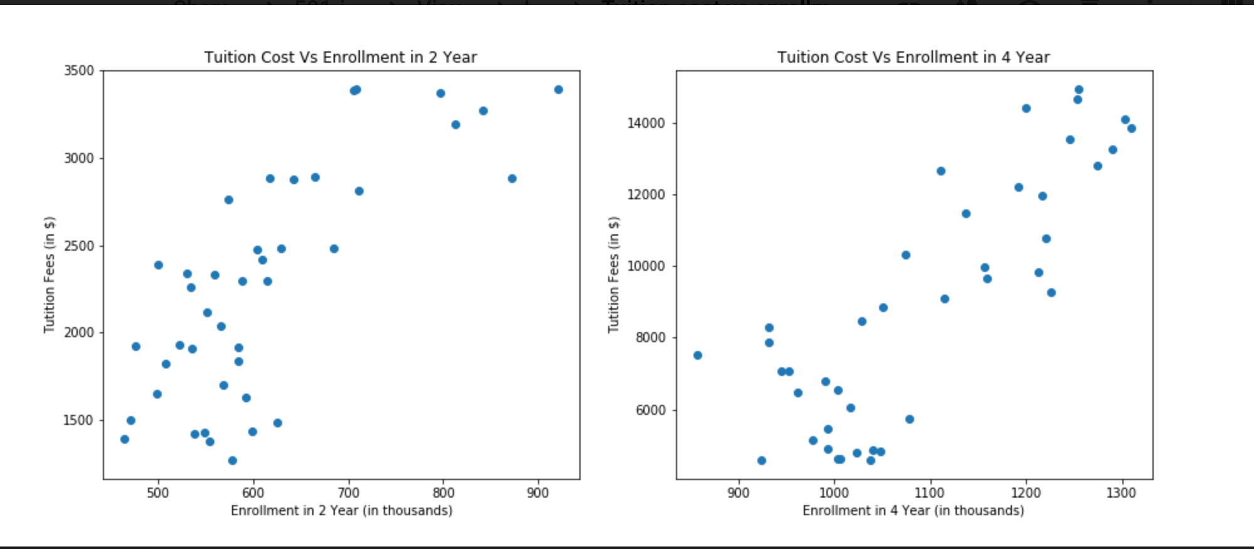
Total Tuition vs Enrollment
2 year:
High enrollment when
tuition is low
4 year:
Steady growth
Enrollment proportional to tuition
Notes:
Scatter plot - each dot represent 1 year in the chart
For more no of years, people enrolled to 2 year programs when tuition cost is less.
But there are few years when tuition cost is high, these might be recent years when tuition cost is increased, but have shown more no of students are enrolled in the 2 year program.
4 years programs shows steady growth over the years. The tuition cost and the no of students enrolled are directly proportional to each other.

Slide 21
Extra: Interactive Graphs

Slide 22
Extra: Interactive Graphs

Slide 23
Conclusion

Slide 24
Original assumption:
Due to to the increase in tuition hikes, people would be de-incentivized to pursue higher education options and would rather pursue pursuing alternative routes.
Result:
The data does not support this assumption specifically in 4 year universities enrollment continues to rise.
Whereas in 2 year programs this correlation can be made.
Conclusion
Notes:
trade school, and/or enter the workforce directly.

Slide 25
We can also conclude that:
Tuition costs did not have a direct impact on the decision to pursue higher education.
Other factors play a role: economic stress (job scarcity) [1] , higher experience required upon graduation [1], branding [7] , degree misconception [7].
Conclusion

Slide 26
References
Selingo, J. J., Helvey, K., Heifetz, J., & Gielan, M. (2016, May 31). Two-Thirds of College Grads Struggle to Launch Their Careers. Retrieved from https://hbr.org/2016/05/two-thirds-of-college-grads-struggle-to-launch-their-careers.
Thompson, D. (2017, July 26). This Is the Way the College 'Bubble' Ends. Retrieved from https://www.theatlantic.com/business/archive/2017/07/college-bubble-ends/534915/.
Stage, F. K., & Hossler, D. (n.d.). Differences in family influences on college attendance plans for male and female ninth graders. Retrieved from https://link.springer.com/article/10.1007/BF00992606.
U.S. Military Personnel 1954-2014: The Numbers. (2014, July 30). Retrieved from https://historyinpieces.com/research/us-military-personnel-1954-2014.
Cohen, A. M., & Brawer, F. B. (2003). The American community college. San Francisco: Jossey-Bass.
National Center for Education Statistics: Table 302.10. Recent high school completers and their enrollment in college, by sex and level of institution: 1960 through 2016, https://nces.ed.gov/programs/digest/d17/tables/dt17_302.10.asp.
Gross, A., & Marcus, J. (2018, April 25). High-Paying Trade Jobs Sit Empty, While High School Grads Line Up For University. Retrieved from https://www.npr.org/sections/ed/2018/04/25/605092520/high-paying-trade-jobs-sit-empty-while-high-school-grads-line-up-for-university.

Slide 27
Appendix
https://drive.google.com/file/d/1DncroQnug4akd1q8vQO9hgdXmlXYCDnb/view?usp=sharing

